Slide 1
Unit 2 Day 3
Graham Tectonics Lab

Slide 2
Bell Ringer
1. Why was plate tectonics theory
accepted over continental drift?
2. Which is the densest layer of
Earth made of heavy metals: nickel
and iron?
3. Which two layers of Earth make up tectonic plates?

Slide 3
Current Event
Record: 2-sentence summary (2 pts)
1 new fact you learned (1 pt)
1 question you are left with! (1 pt)
Be a respectful audience member ☺ (1 pt)

Slide 4
Test Data

Slide 5
Inquiry Lab: Graham Tectonics
Work in pairs to re-create each type of plate boundary.
READ THE DIRECTIONS CAREFULLY!
As soon as you complete the pre-lab, you may begin.

Slide 6
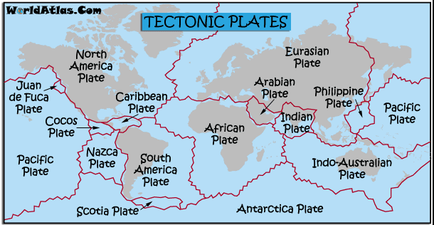
Background
The Earth’s lithosphere (crust + upper mantle) is divided into 7-13 large tectonic plates.
Where plates meet (plate boundaries):
Rift Valleys
Mountains
Volcanoes
Earthquakes
Mid-ocean ridges
New seafloor created!

Slide 7
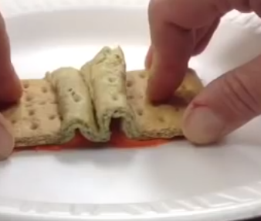
Graham Lab: What did each item represent?
Graham Cracker
Whipped frosting
Fruit roll-up?!

Slide 8
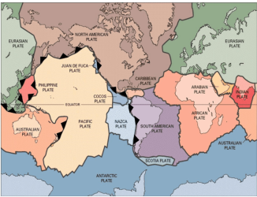
Plate Tectonics Theory
Newer, accepted theory
Plates constantly move (at different speeds)
Evidence: Earthquakes, volcanoes, mountains, trenches occur at plate boundaries

Slide 9
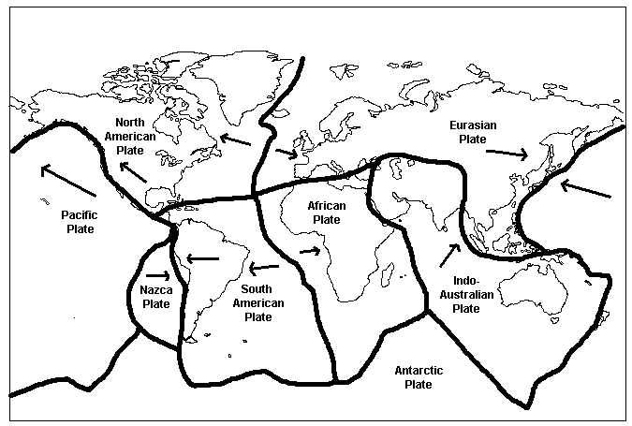
Plate Boundaries: Label your map!
Boundary: where the edges of two plates meet
(1) Convergent
Co = together
(2) Divergent
Di = separate
(3) Transform
https://ees.as.uky.edu/sites/default/files/elearning/module04swf.swf

Slide 10
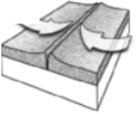
Convergent
Two plates move together, crust is destroyed
Ocean-Land
Subduction zone (ocean plate sinks under less dense land plate)
Volcanic mountains
Land-Land
Mountains

Slide 11
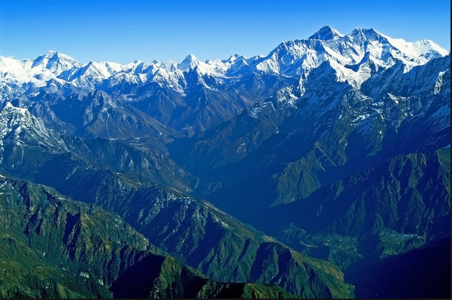
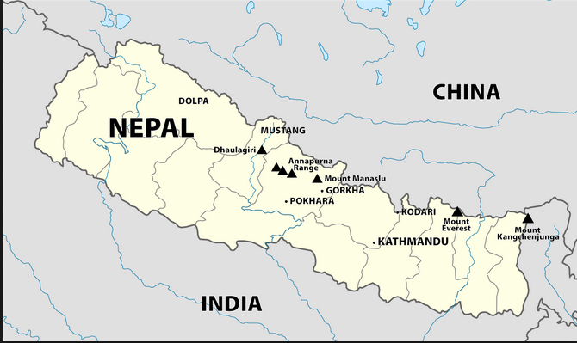
Location: Himalayan Mountains, Nepal
Plates Involved:
Mt. Everest: rising 2.4 inches per year!
Boundary:
Event/Landform: shallow earthquake activity
THINK: Which east coast mountain range
was created by convergent continental plates?

Slide 12
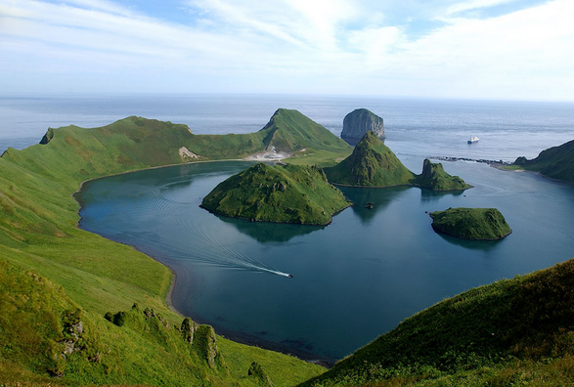
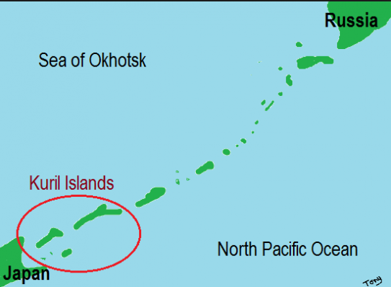
Location: Kuril Islands, Japan
Plates Involved:
Depth 100 miles: subducting ocean plate melts!
Zone of earthquake activity
Chain of volcanic islands
Destroys ocean crust
Boundary:
Event/Landform:

Slide 13
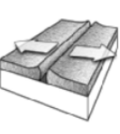
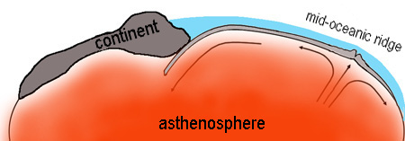
Divergent
Two plates move apart
New crust is formed
Land-Land:
Rift Valley
Ocean-Ocean:
Seafloor spreading (new seafloor)
Mid-ocean ridge
Notes:
https://www.youtube.com/watch?v=2q4Yqctq6nE

Slide 14
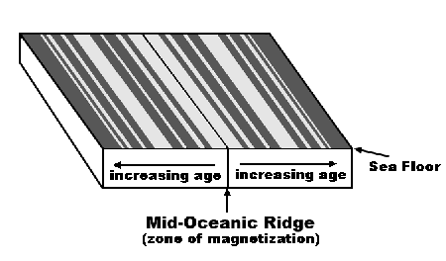
Where is the youngest seafloor found? Oldest?

Slide 15
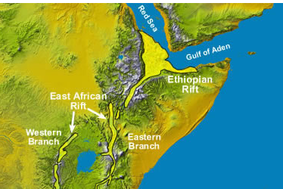
Location: East Africa Rift Valley
Plates Involved:
Land plates pull apart
Early formation: creates a lake
Can create an ocean basin over time
Boundary:
Event/Landform:

Slide 16
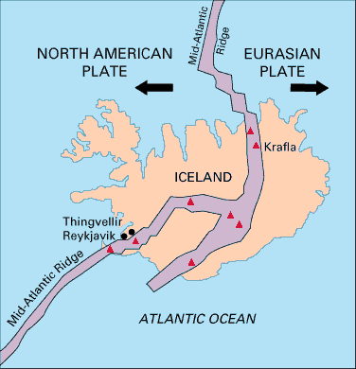
Location: Iceland, Mid-Atlantic Ridges
Plates Involved:
Submarine mountains
Volcanic activity
Shallow earthquake activity
Create new seafloor/ocean crust!
Boundary:
Event/Landform:

Slide 17
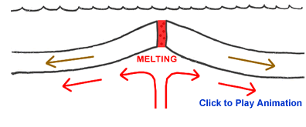

Slide 18
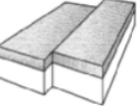
Transform-Fault
Two plates grind slowly past each other
Crust is not created or destroyed
Earthquakes can occur

Slide 19
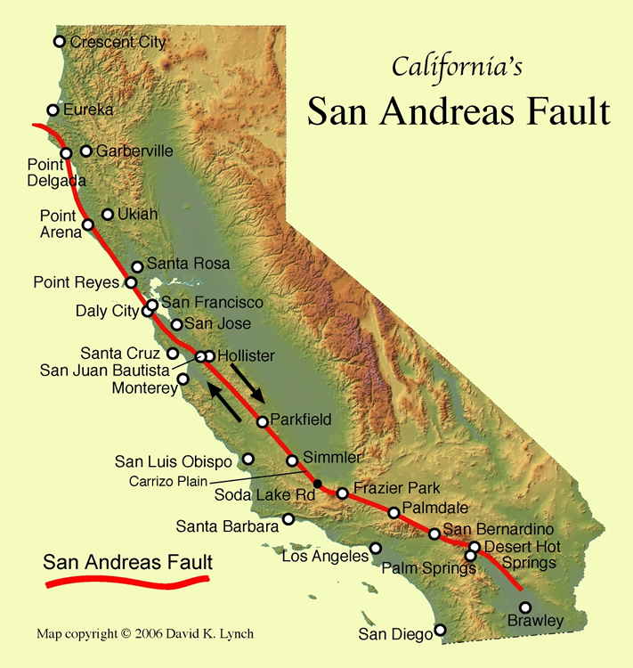
Location, San Andreas Fault Zone
Plates Involved:
Boundary:
Event/Landform: shallow earthquake zone
THINK: Would volcanic activity occur here?

Slide 20
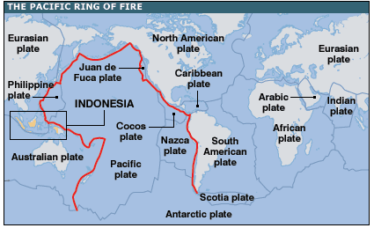
Label the Ring of Fire on your map!

Slide 21
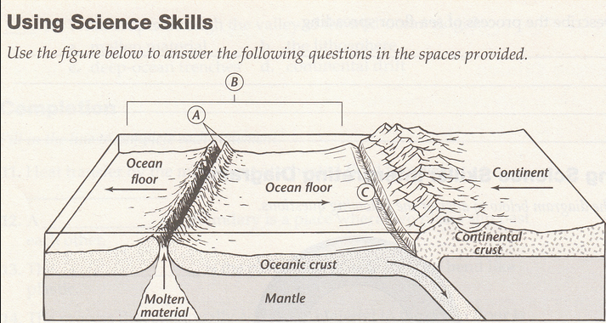
Exit Ticket: Turn in before you leave!
A-C:
Plates (crust) involved
Type of boundary (C, D, or T)
Event/Landform (i.e. mountain, volcano, new seafloor)

Slide 22
Quiz Tuesday ☺
Layers of the Earth
Continental Drift Theory
Plate Tectonics Theory (newer, accepted)
(3) Types of Plate Boundaries
Actions that occur at each boundary!

